Slide 1

Dan Jurafsky and James Martin
Speech and Language Processing
Chapter 6:
Vector Semantics, Part II

Slide 2
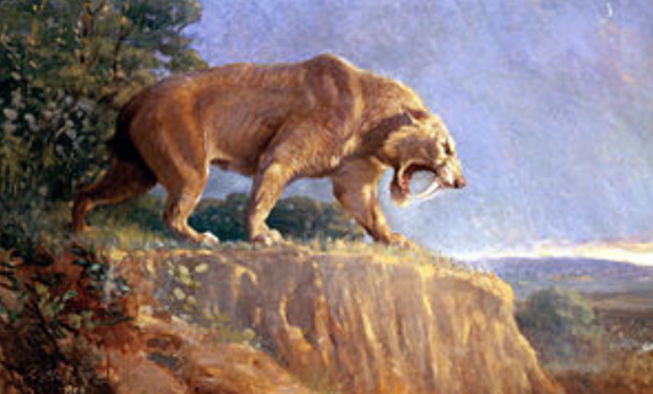
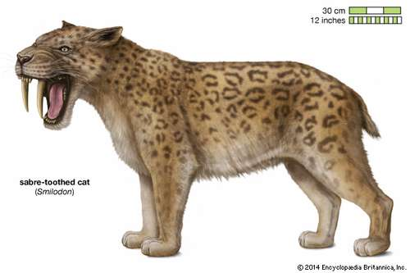
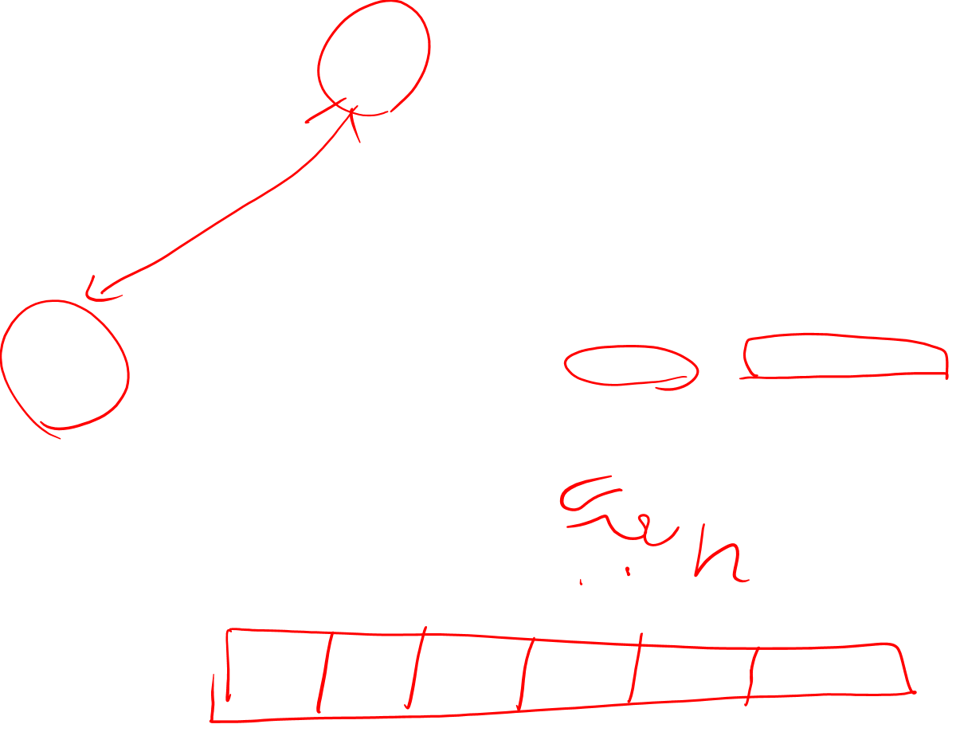
Similarity
The similarity of these two mammals is one of many examples of parallel or convergent evolution, in which particular contexts or environments lead to the evolution of very similar structures in different species (Gould, 1980).

Slide 3
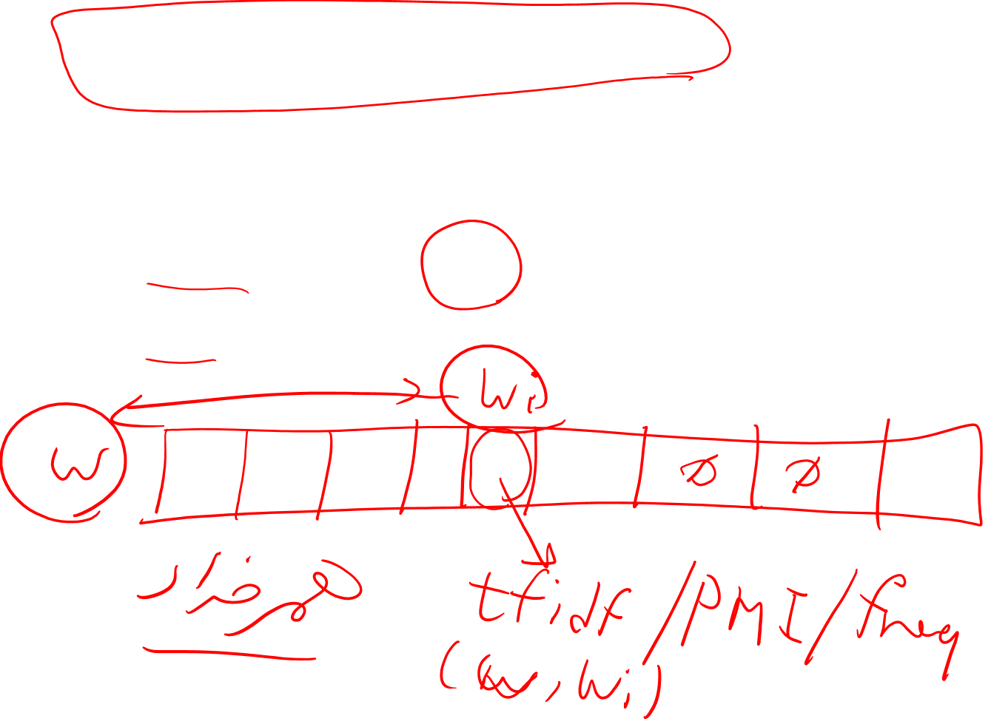
Tf-idf and PPMI are sparse representations
tf-idf and PPMI vectors are
long (length |V|= 20,000 to 50,000)
sparse (most elements are zero)

Slide 4
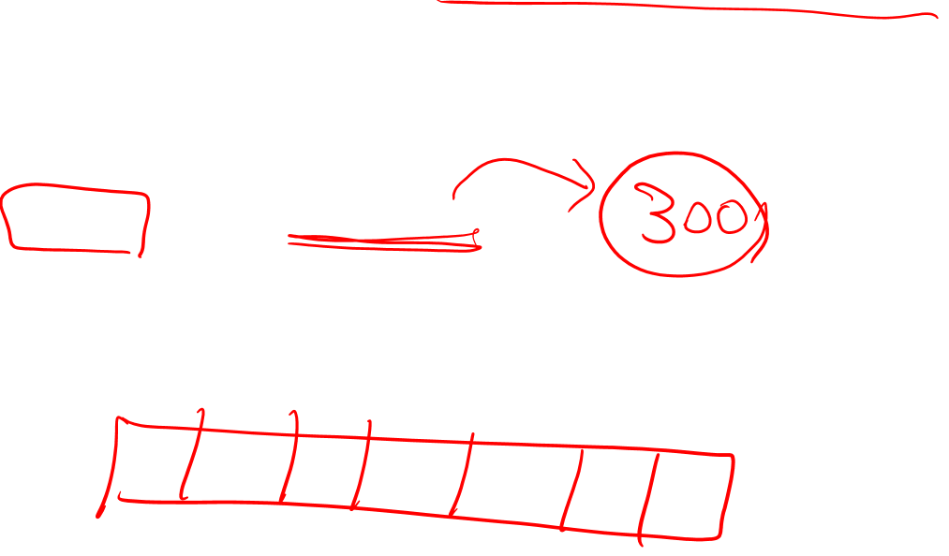
Alternative: dense vectors
vectors which are
short (length 50-1000)
dense (most elements are non-zero)

Slide 5
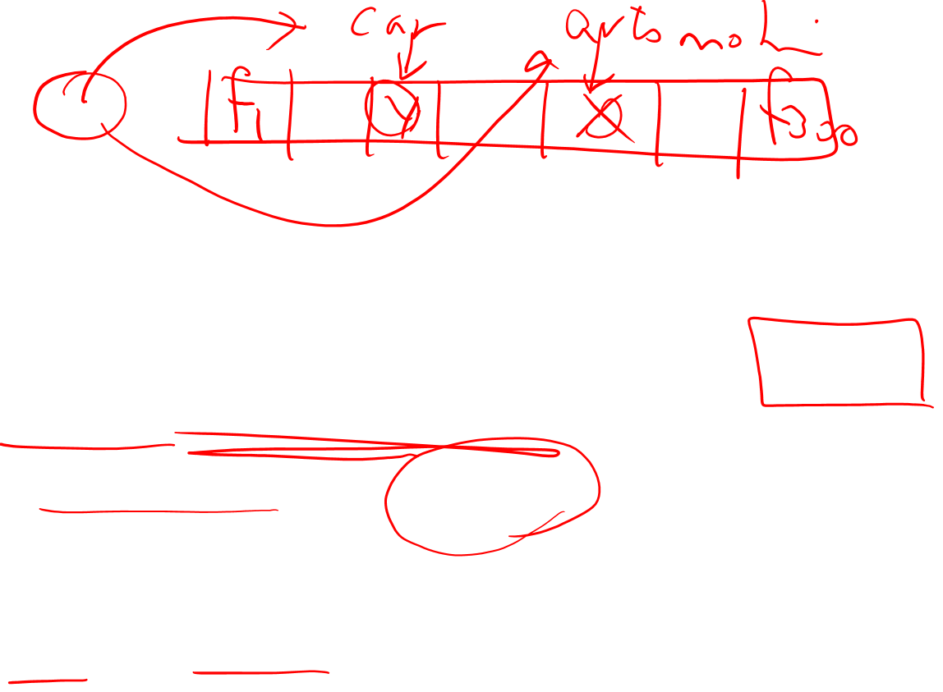
Sparse versus dense vectors
Why dense vectors?
Short vectors may be easier to use as features in machine learning (less weights to tune)
Dense vectors may generalize better than storing explicit counts
They may do better at capturing synonymy:
car and automobile are synonyms; but are distinct dimensions
a word with car as a neighbor and a word with automobile as a neighbor should be similar, but aren't
In practice, they work better

Slide 6


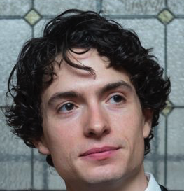

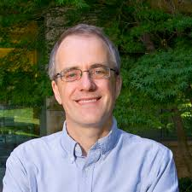
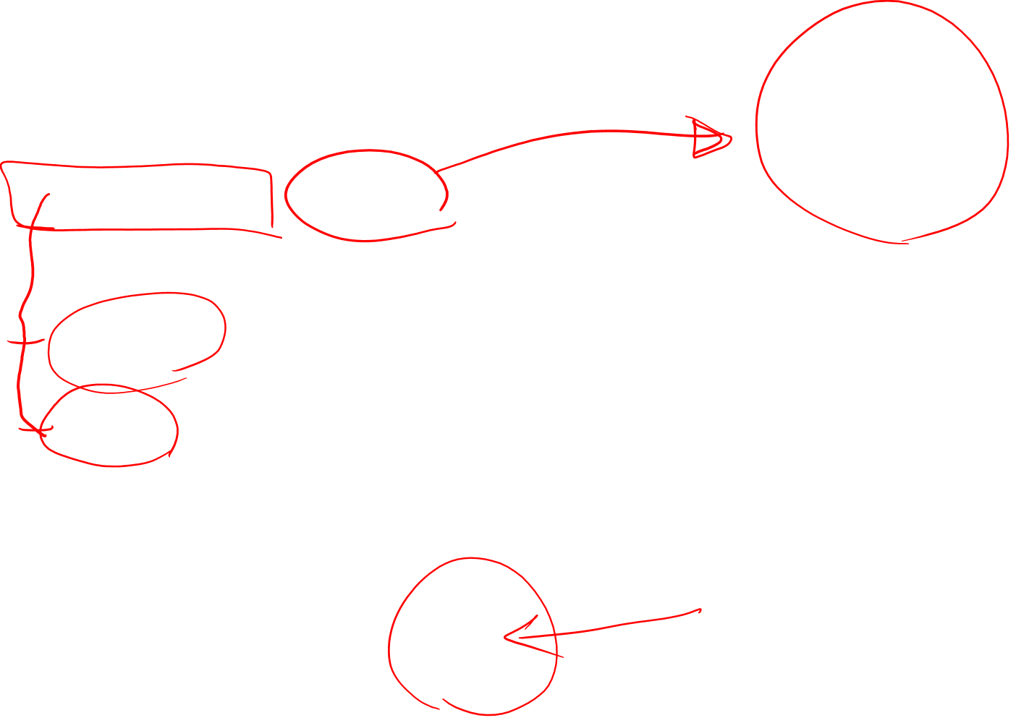
Dense embeddings you can download!
Word2vec (Mikolov et al.)
https://code.google.com/archive/p/word2vec/
Fasttext http://www.fasttext.cc/
Glove (Pennington, Socher, Manning)
http://nlp.stanford.edu/projects/glove/

Slide 7
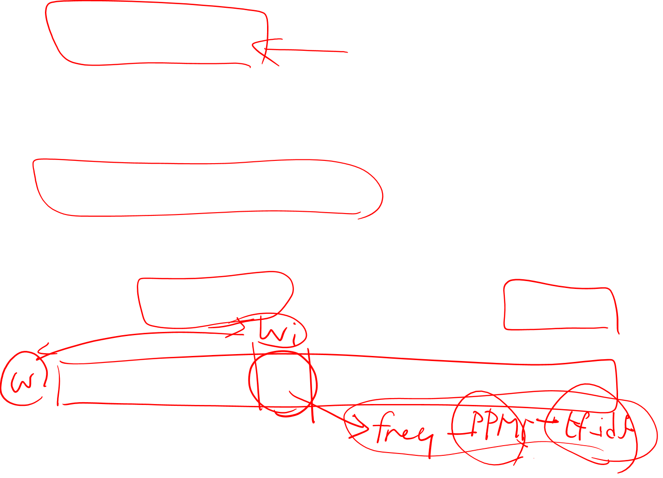
Word2vec
Popular embedding method
Very fast to train
Code available on the web
Idea: predict rather than count

Slide 8
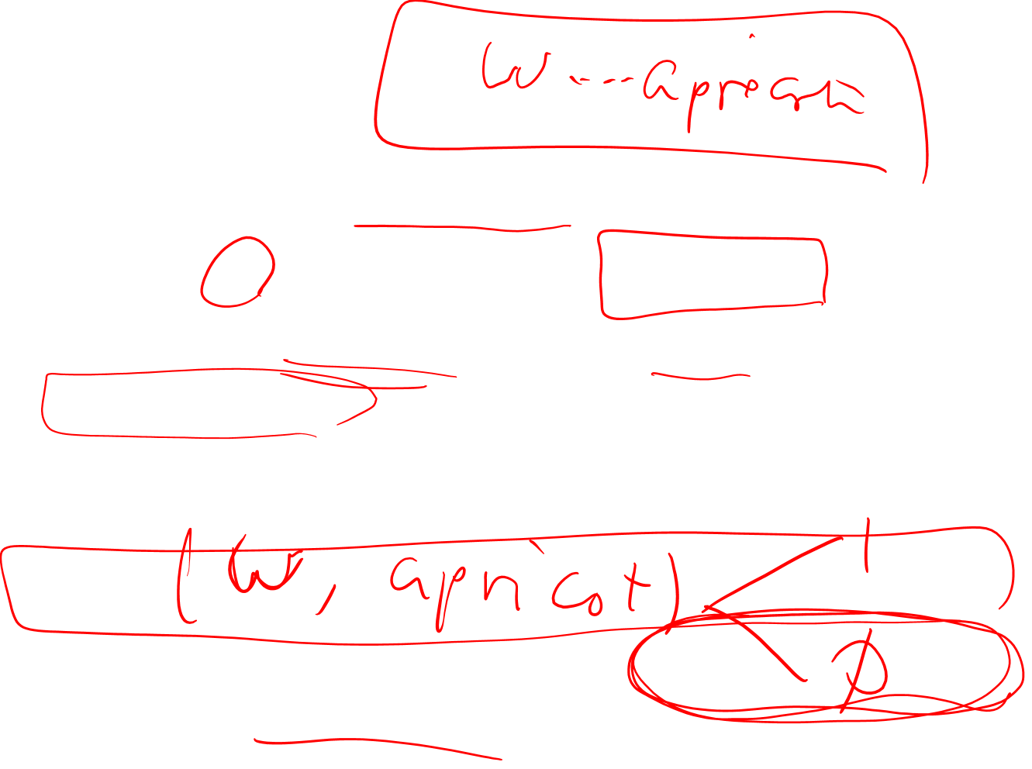
Word2vec
Instead of counting how often each word w occurs near "apricot"
Train a classifier on a binary prediction task:
Is w likely to show up near "apricot"?
We don’t actually care about this task
But we'll take the learned classifier weights as the word embeddings

Slide 9
Brilliant insight: Use running text as implicitly supervised training data!
A word s near apricot
Acts as gold ‘correct answer’ to the question
“Is word w likely to show up near apricot?”
No need for hand-labeled supervision
The idea comes from neural language modeling
Bengio et al. (2003)
Collobert et al. (2011)

Slide 10
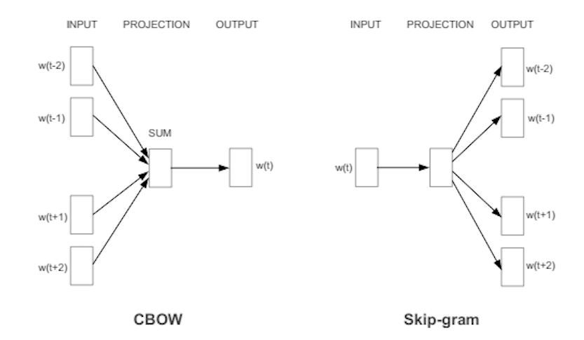
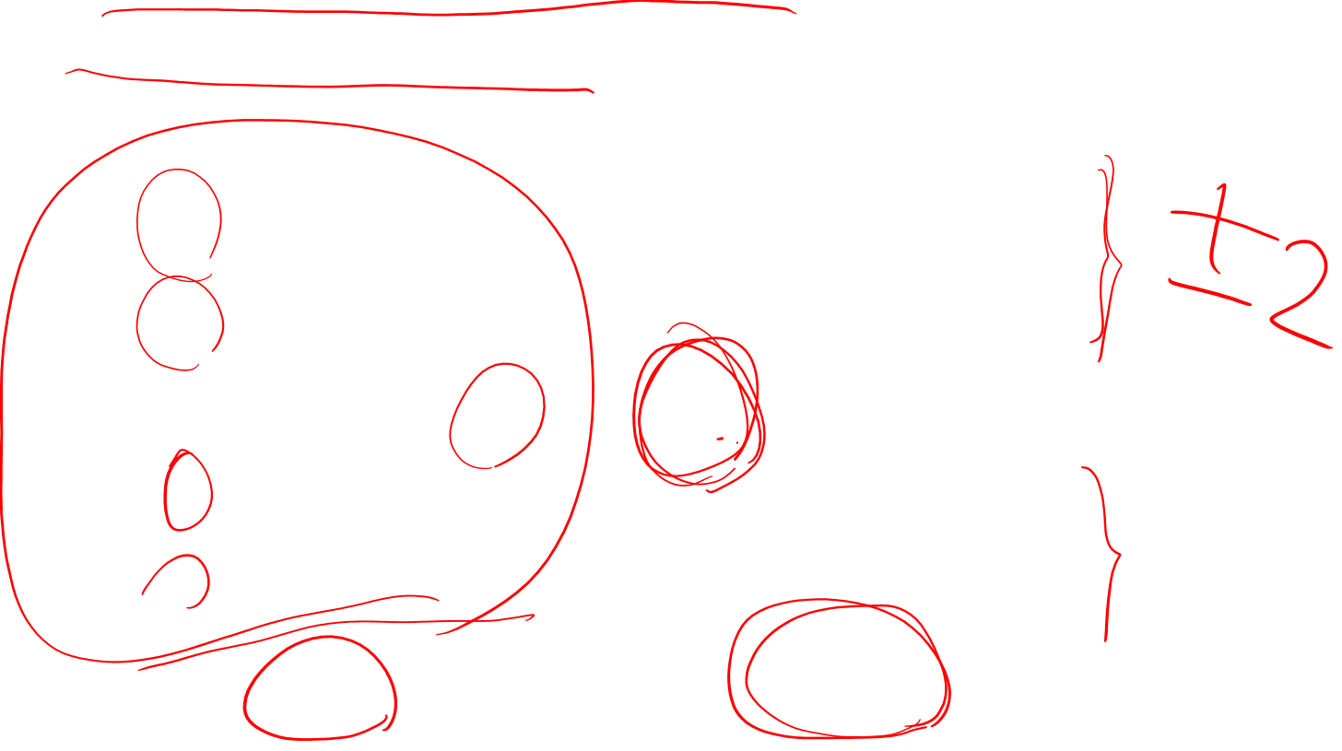
Word2Vec: Skip-Gram Task
Word2vec provides a variety of options. Let's do
"skip-gram with negative sampling" (SGNS)
“continuous bag or word (CBOW)”

Slide 11
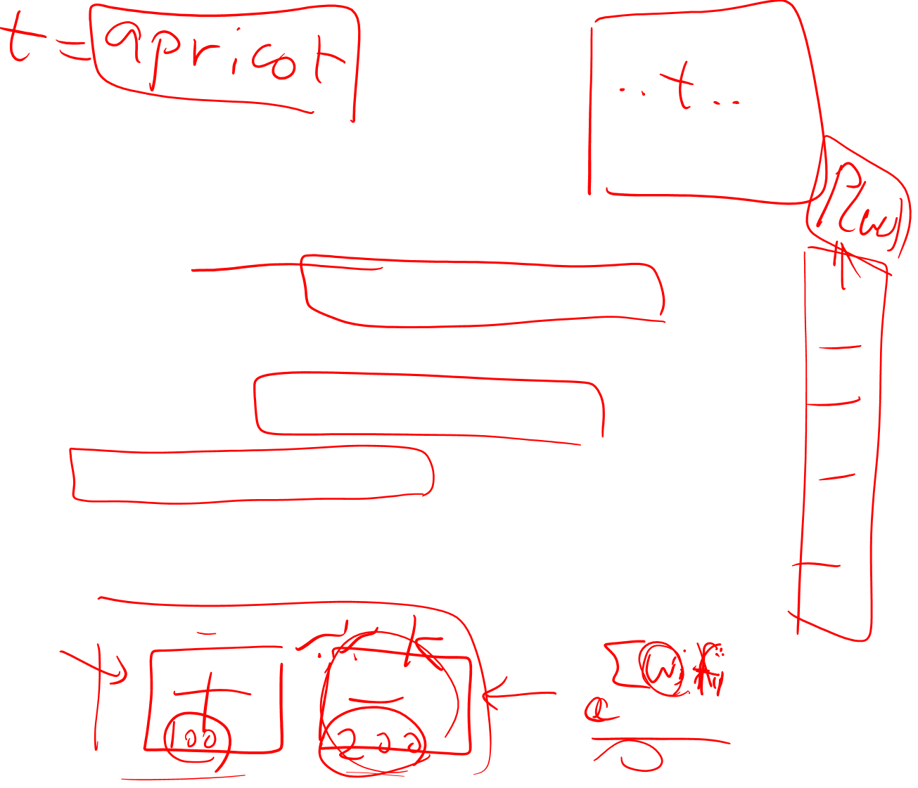
Skip-gram algorithm
Treat the target word and a neighboring context word as positive examples.
Randomly sample other words in the lexicon to get negative samples
Use logistic regression to train a classifier to distinguish those two cases
Use the weights as the embeddings

Slide 12

Skip-Gram Training Data
Training sentence:
... lemon, a tablespoon of apricot jam a pinch ...
c1 c2 target c3 c4
Asssume context words are those in +/- 2 word window

Slide 13
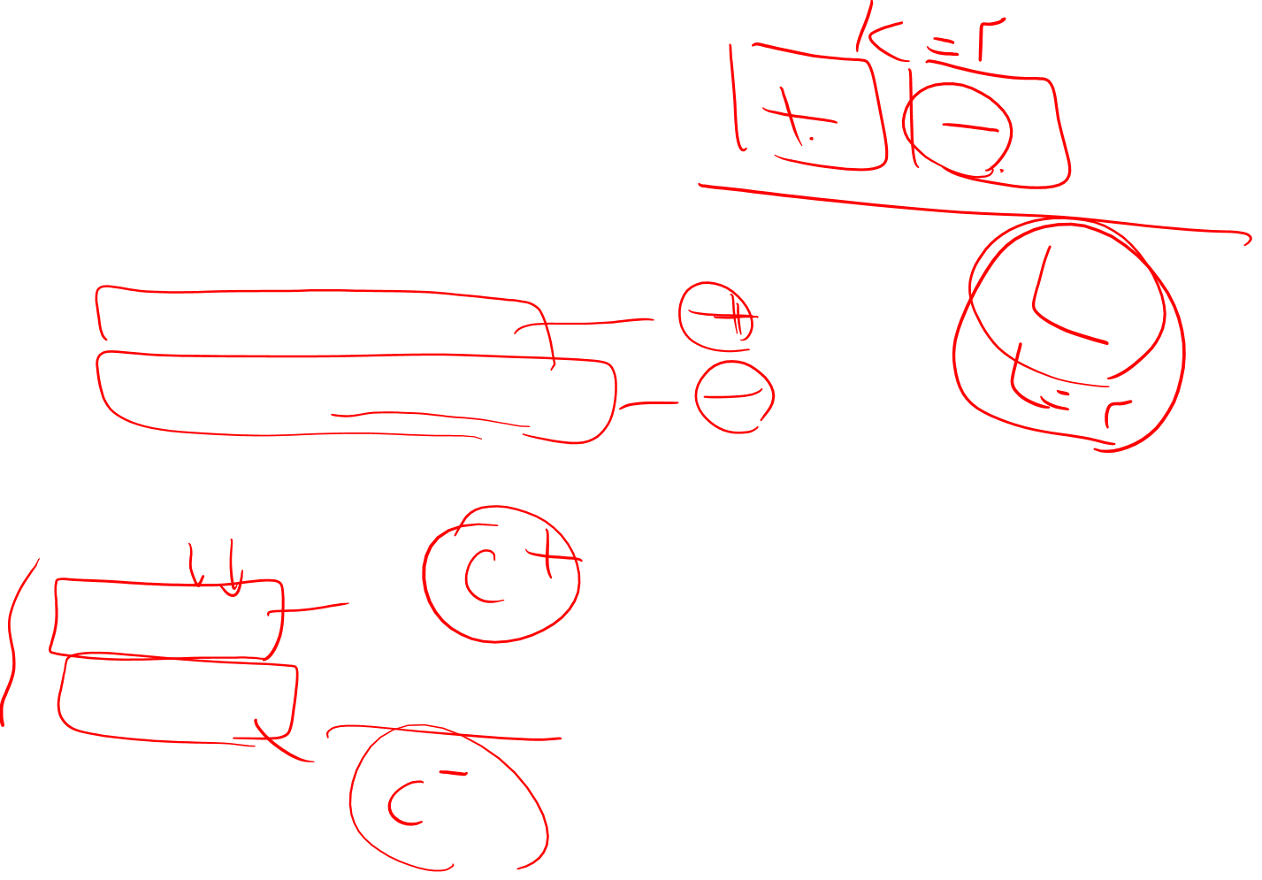
Skip-Gram Goal
Given a tuple (t,c) = target, context
(apricot, jam)
(apricot, aardvark)
Return probability that c is a real context word:
P(+|t,c)
P(−|t,c) = 1−P(+|t,c)

Slide 14
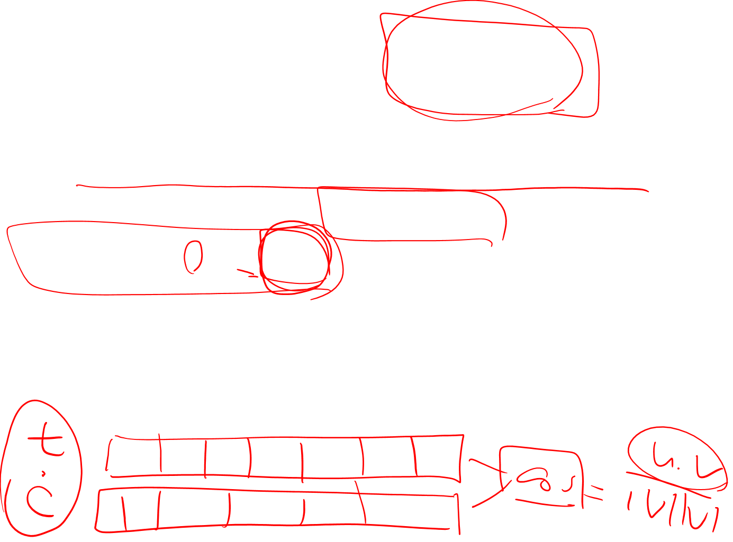
How to compute p(+|t,c)?
Intuition:
Words are likely to appear near similar words
Model similarity with dot-product!
Similarity(t,c) ∝ t ∙ c
Problem:
Dot product is not a probability!
(Neither is cosine)

Slide 15
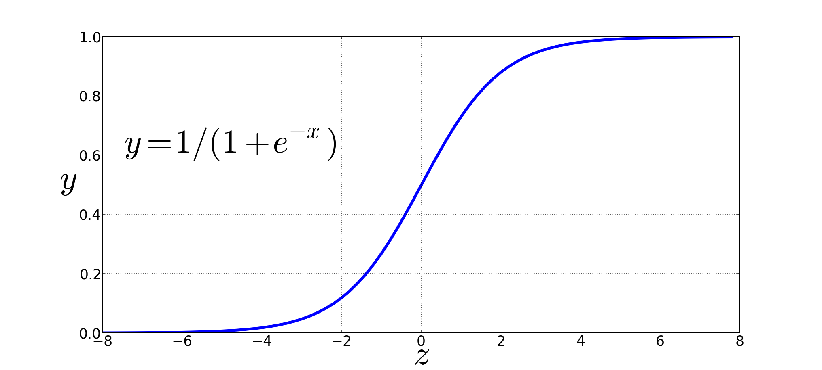

Turning dot product into a probability
The sigmoid lies between 0 and 1:

Slide 16
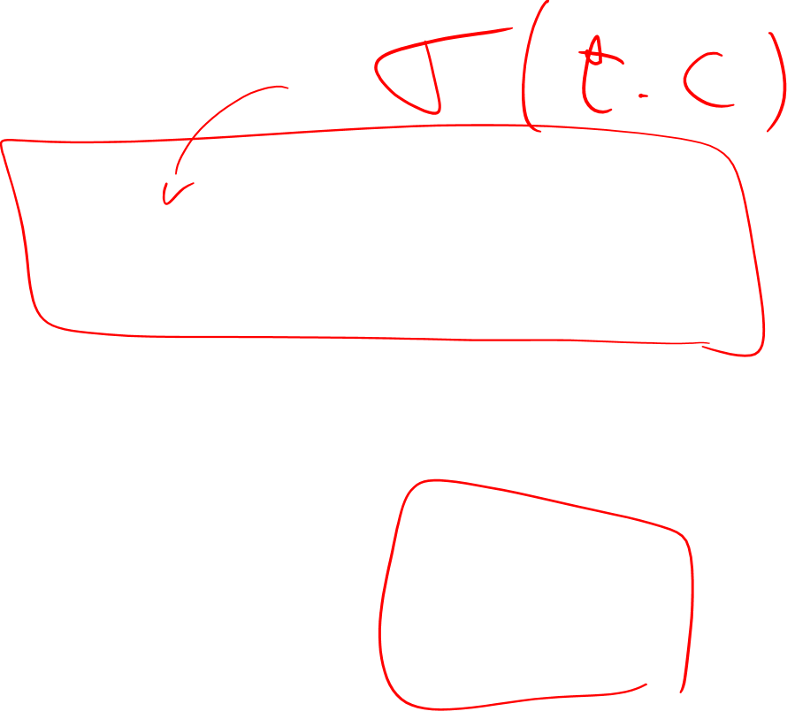
Turning dot product into a probability

Slide 17
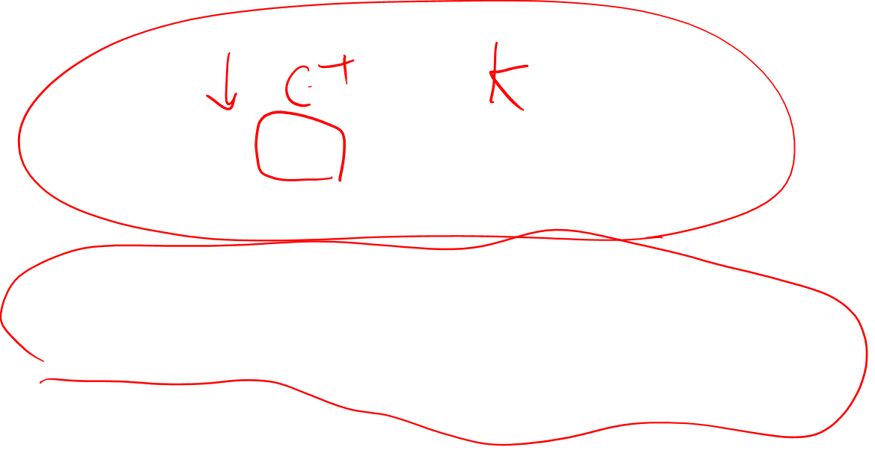
For all the context words:
Assume all context words are independent

Slide 18

Skip-Gram Training Data
Training sentence:
... lemon, a tablespoon of apricot jam a pinch ...
c1 c2 t c3 c4
Training data: input/output pairs centering on apricot
Asssume a +/- 2 word window

Slide 19

Skip-Gram Training
Training sentence:
... lemon, a tablespoon of apricot jam a pinch ...
c1 c2 t c3 c4
For each positive example, we'll create k negative examples.
Using noise words
Any random word that isn't t

Slide 20

Skip-Gram Training
Training sentence:
... lemon, a tablespoon of apricot jam a pinch ...
c1 c2 t c3 c4
k=2

Slide 21
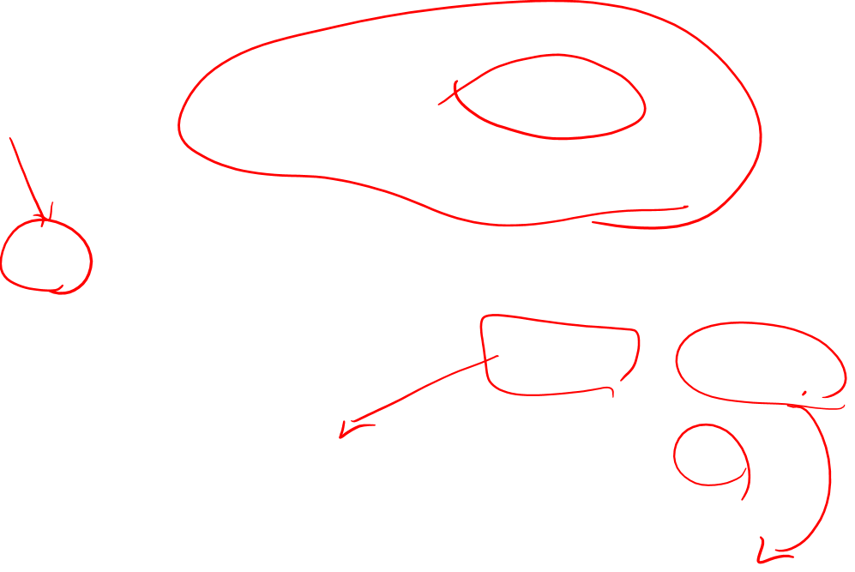
Choosing noise words
Could pick w according to their unigram frequency P(w)
More common to chosen then according to p_{α}(w)
α= ¾ works well because it gives rare noise words slightly higher probability
To show this, imagine two events p(a)=.99 and p(b) = .01:

Slide 22
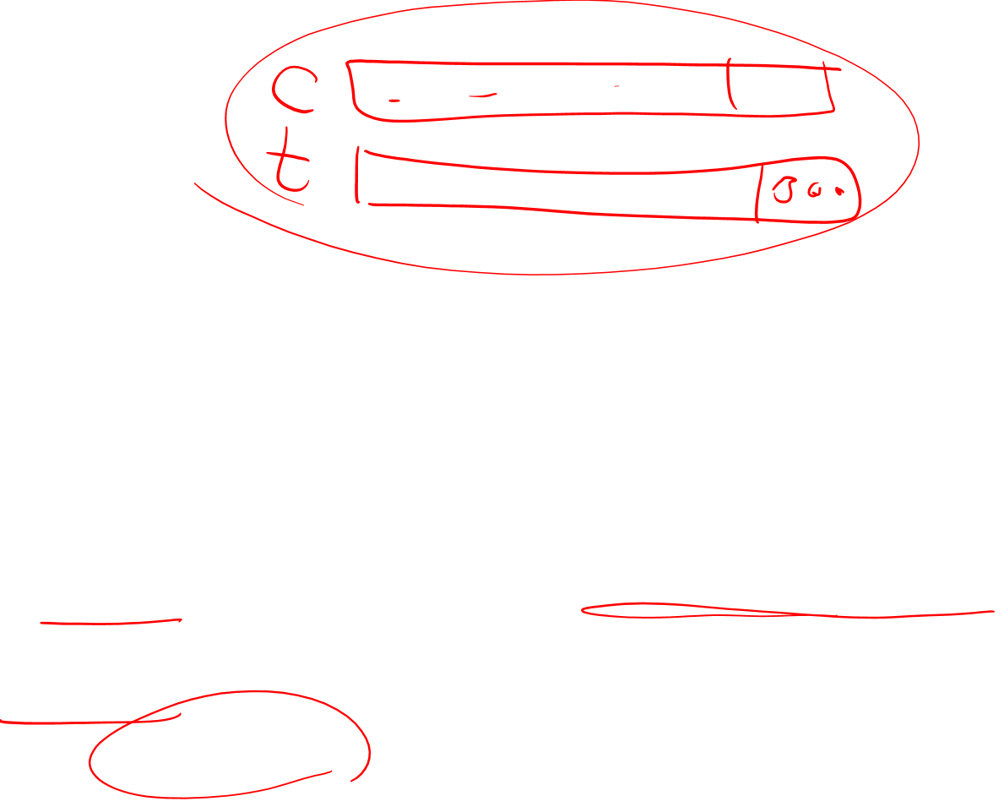
Setup
Let's represent words as vectors of some length (say 300), randomly initialized.
So we start with 300 * V random parameters
Over the entire training set, we’d like to adjust those word vectors such that we
Maximize the similarity of the target word, context word pairs (t,c) drawn from the positive data
Minimize the similarity of the (t,c) pairs drawn from the negative data.

Slide 23

Learning the classifier
Iterative process.
We’ll start with 0 or random weights
Then adjust the word weights to
make the positive pairs more likely
and the negative pairs less likely
over the entire training set:

Slide 24

Objective Criteria
We want to maximize…
Maximize the + label for the pairs from the positive training data, and the – label for the pairs sample from the negative data.

Slide 25

Focusing on one target word t:

Slide 27
Train using gradient descent
Actually learns two separate embedding matrices W and C
Can use W and throw away C, or merge them somehow

Slide 28

Summary: How to learn word2vec (skip-gram) embeddings
Start with V random 300-dimensional vectors as initial embeddings
Use logistic regression, the second most basic classifier used in machine learning after naïve bayes
Take a corpus and take pairs of words that co-occur as positive examples
Take pairs of words that don't co-occur as negative examples
Train the classifier to distinguish these by slowly adjusting all the embeddings to improve the classifier performance
Throw away the classifier code and keep the embeddings.

Slide 29
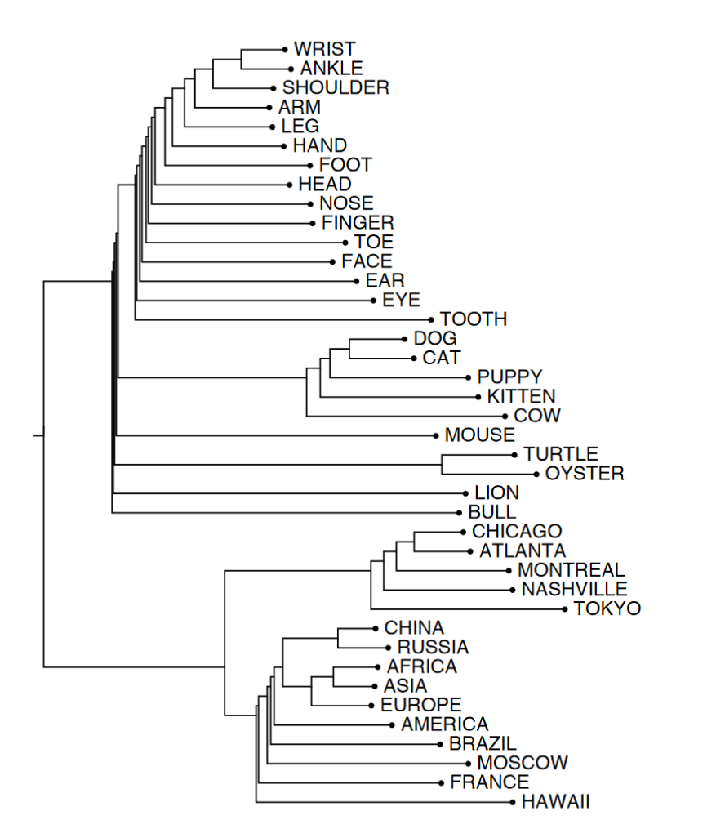
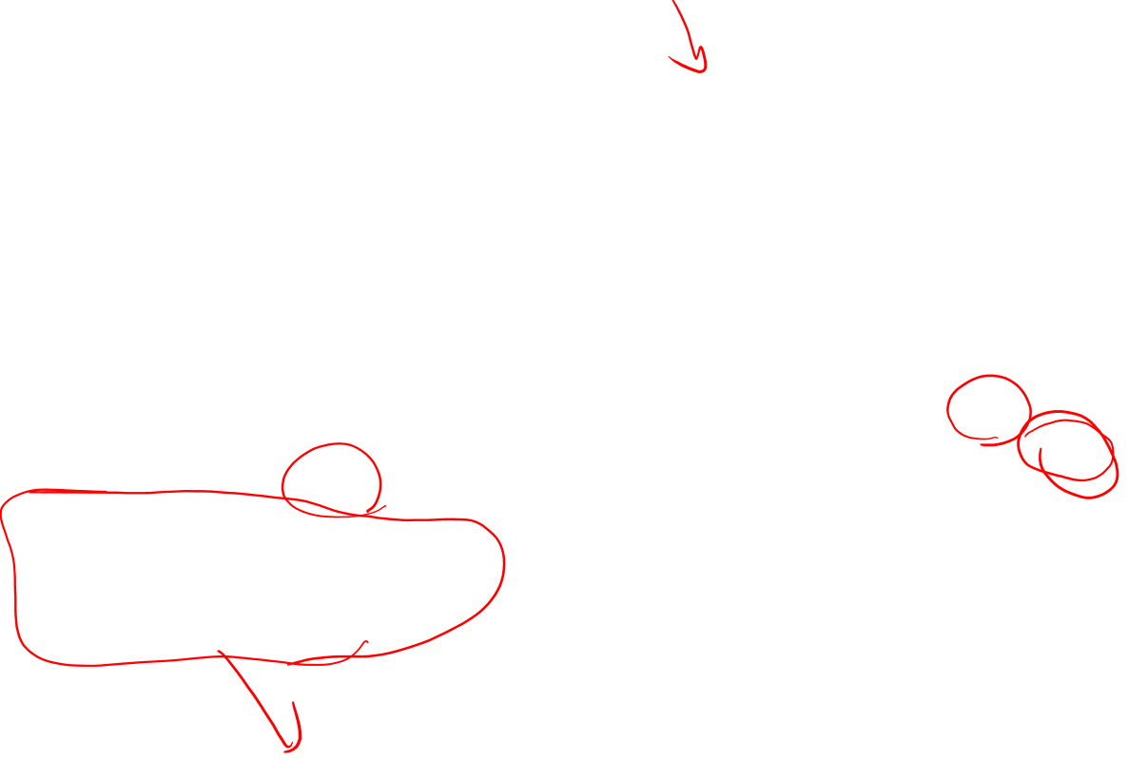
Visualizing Embeddings
sorting all words in the vocabulary by their
Cosines
7 closest words to frog :
frogs, toad, litoria, leptodactylidae, rana, lizard, and eleutherodactylus

Slide 30
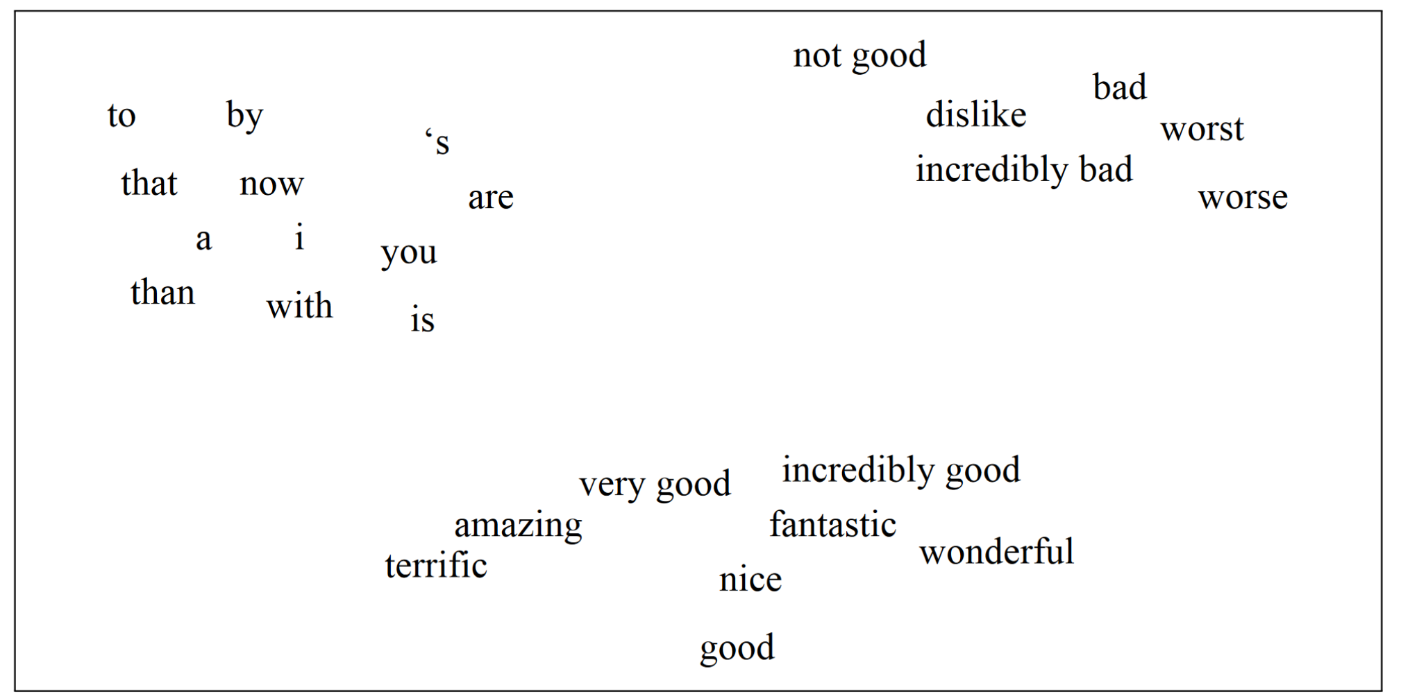
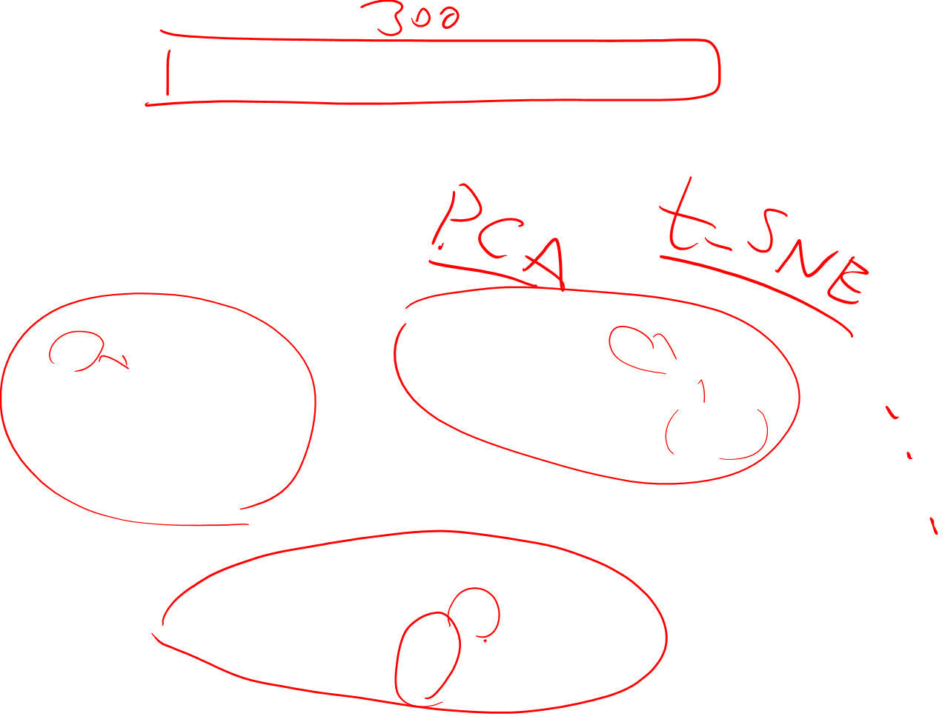
Visualizing Embeddings
Low dimensional visualization

Slide 31

Evaluating embeddings
Compare to human scores on word similarity-type tasks:
WordSim-353 (Finkelstein et al., 2002)
SimLex-999 (Hill et al., 2015)
Stanford Contextual Word Similarity (SCWS) dataset (Huang et al., 2012)
TOEFL dataset: Levied is closest in meaning to: imposed, believed, requested, correlated

Slide 32
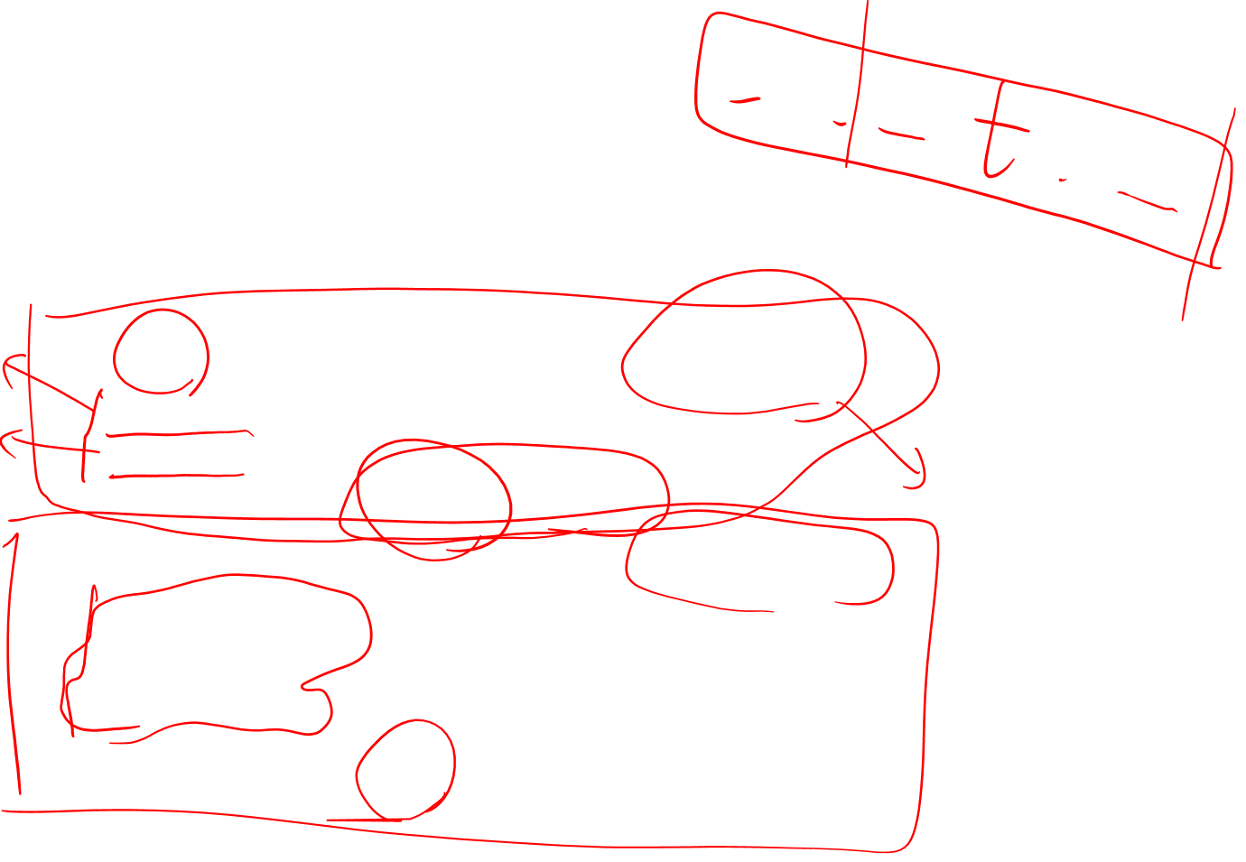
Properties of embeddings
Similarity depends on window size C
C = ±2 The nearest words to Hogwarts:
Sunnydale
Evernight
Short context: Syntactic similarity
C = ±5 The nearest words to Hogwarts:
Dumbledore
Malfoy
Halfblood
Long context: topical similarity

Slide 33
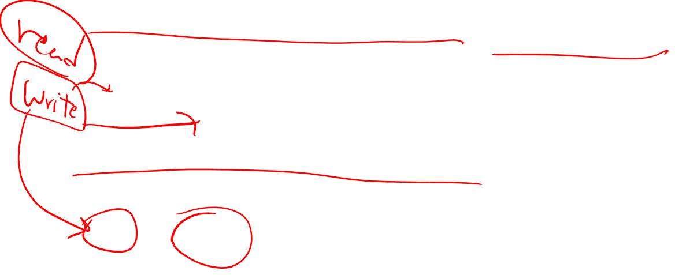
first-order co-occurrence: syntagmatic association
Book or poem
second-order co-occurrence: paradigmatic association
Said or remarked

Slide 34
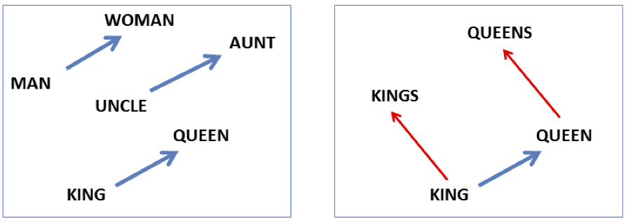
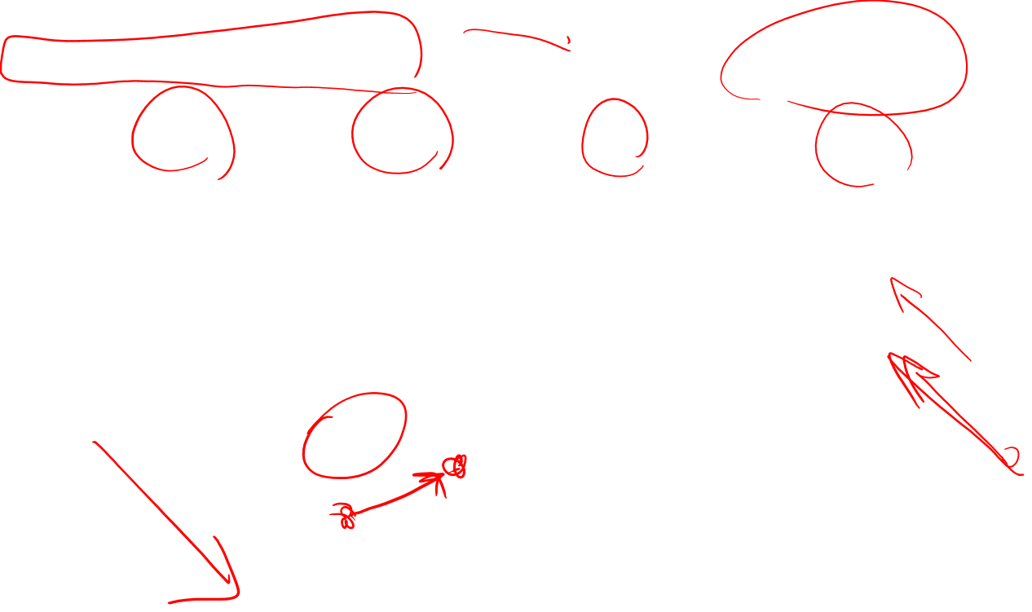
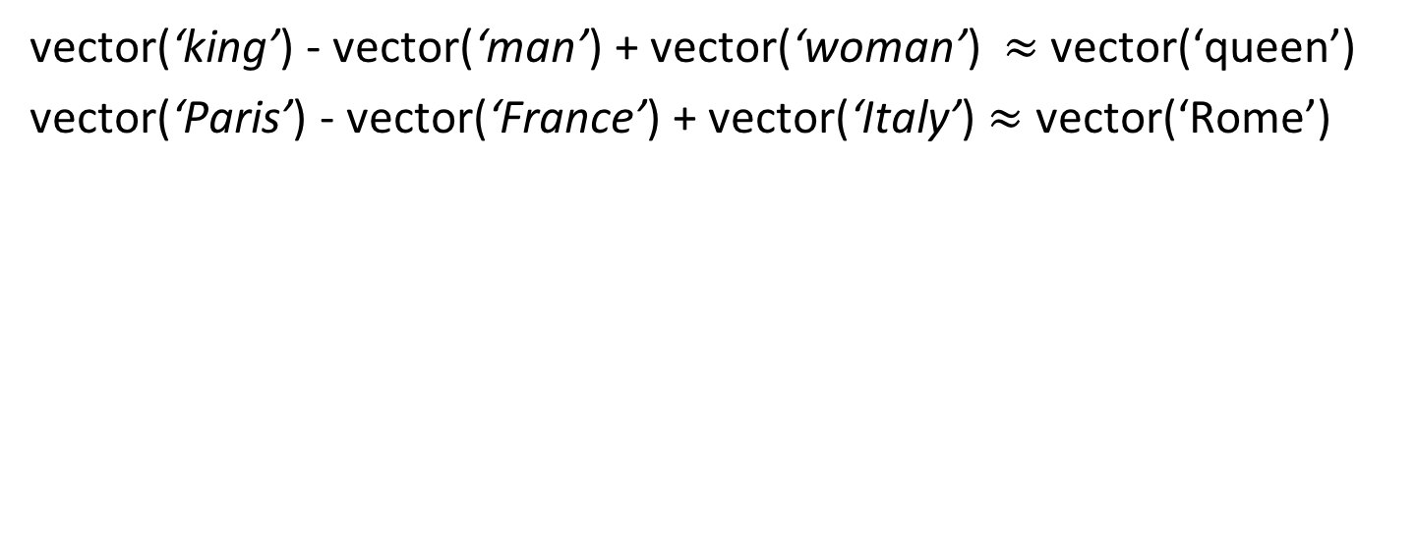
Analogy: Embeddings capture relational meaning!
vector(‘king’) - vector(‘man’) + vector(‘woman’) $≈$vector(‘queen’)
vector(‘Paris’) - vector(‘France’) + vector(‘Italy’) $≈$ vector(‘Rome’)

Slide 35
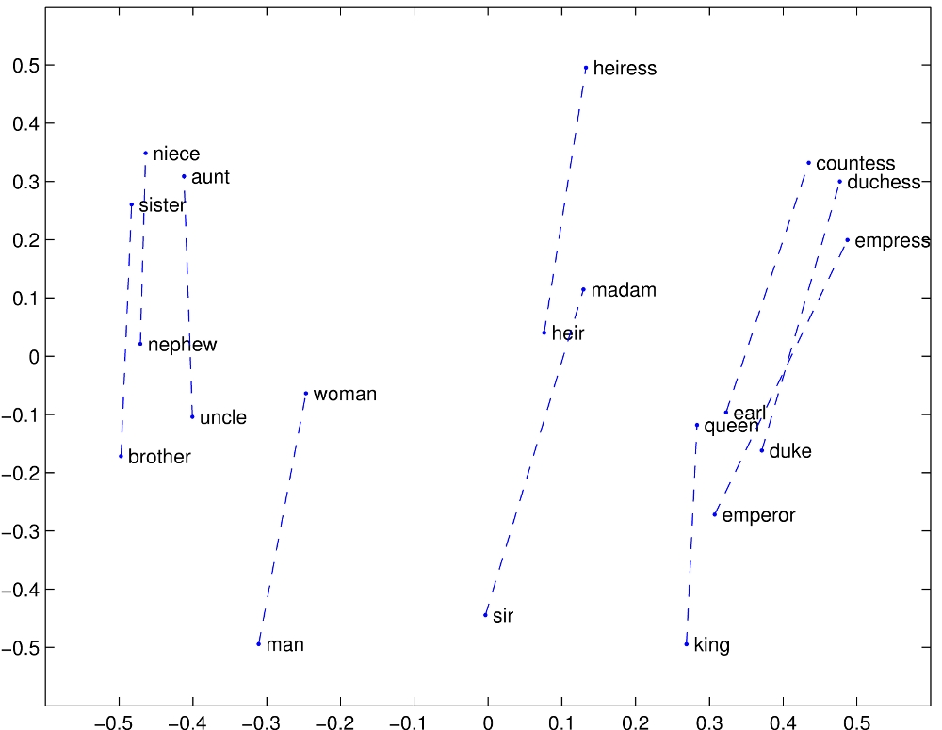


Slide 36
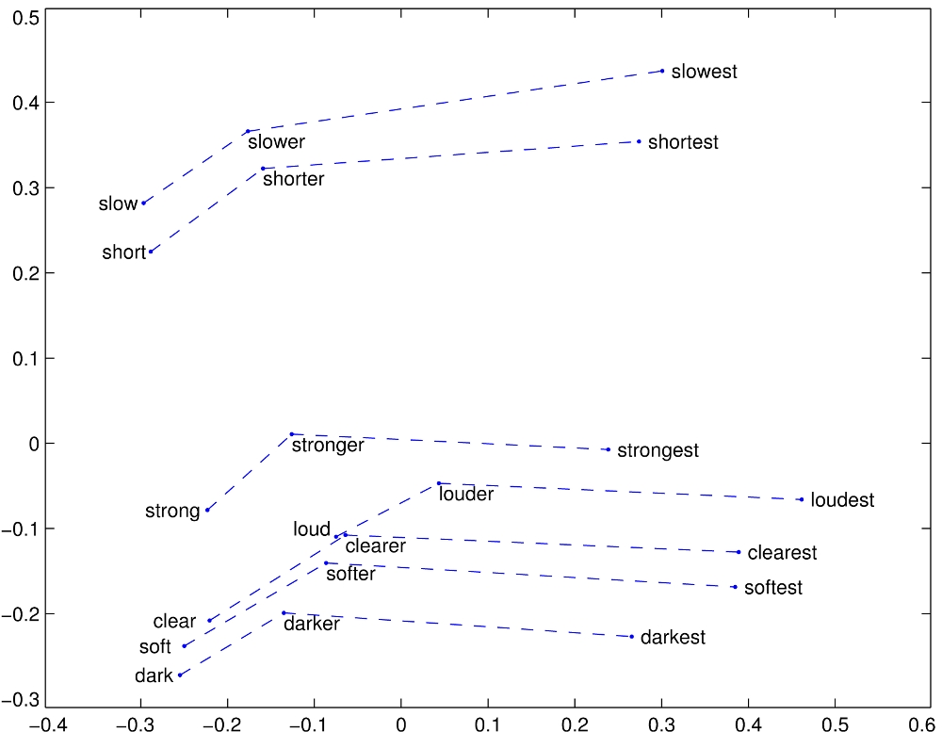


Slide 37


Embeddings can help study word history!
Train embeddings on old books to study changes in word meaning!!
Will Hamilton

Slide 38



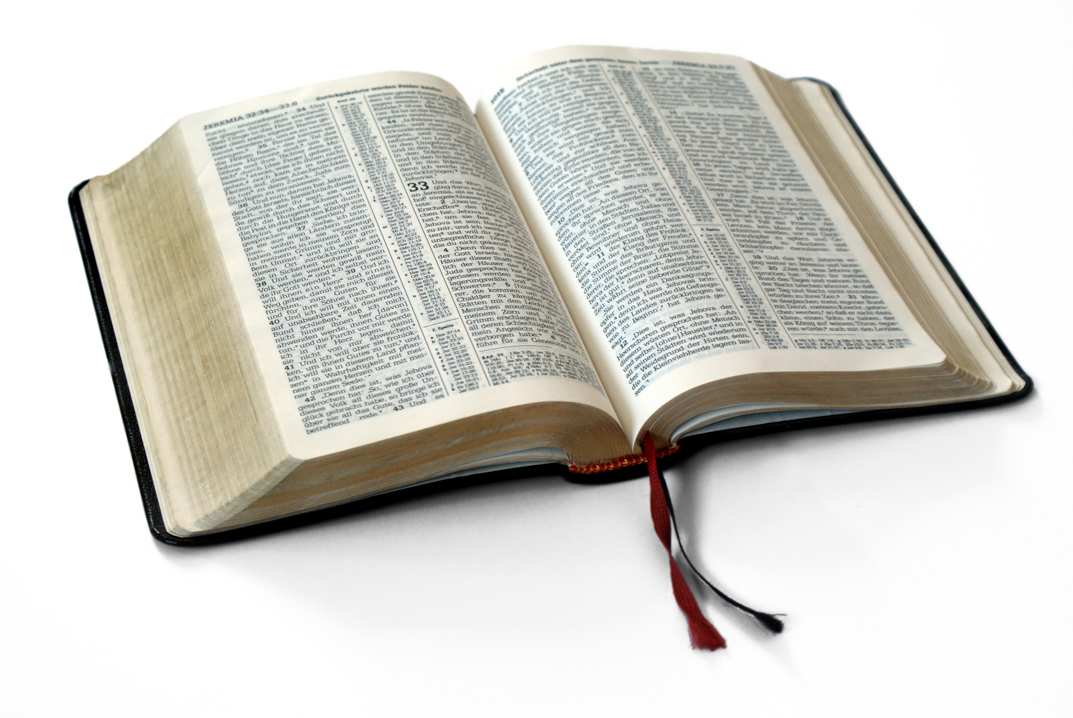
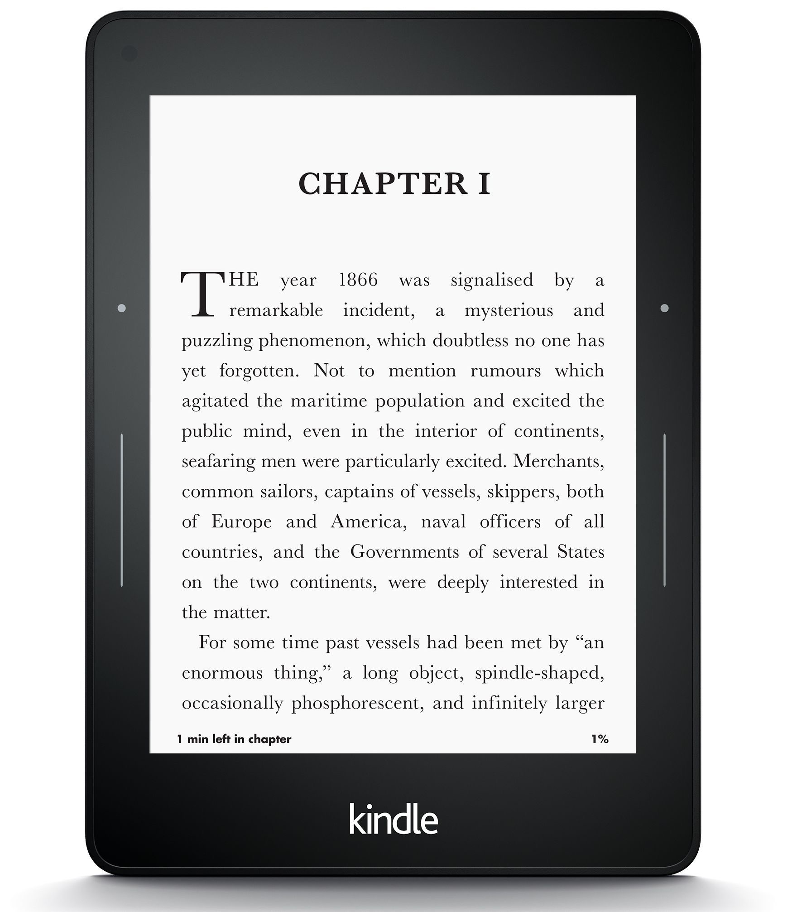
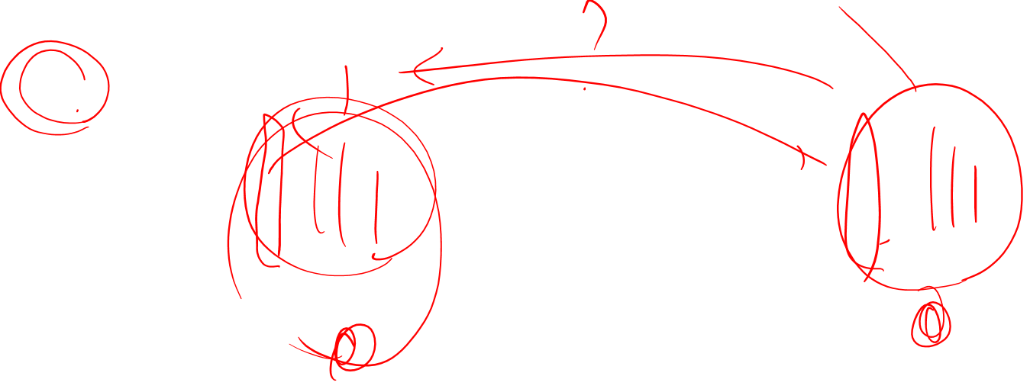
Diachronic word embeddings for studying language change!
Word vectors for 1920
Word vectors 1990
“dog” 1990 word vector
“dog” 1920 word vector
vs.
1900
1950
2000
￼
￼

Slide 39
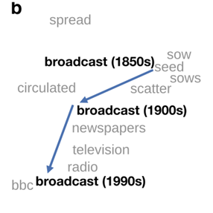
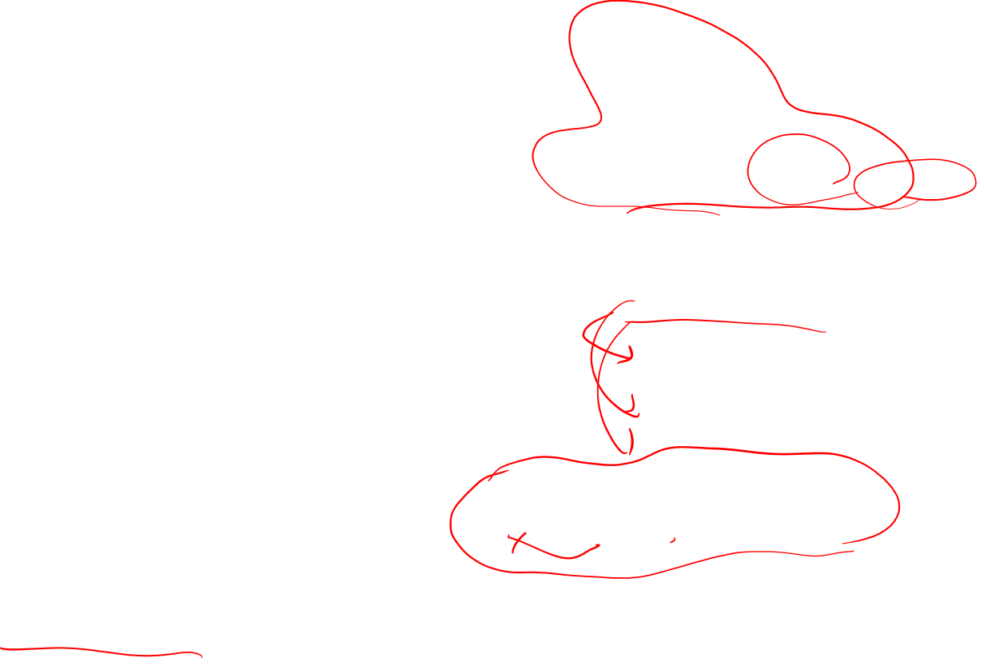
Visualizing changes
Project 300 dimensions down into 2
~30 million books, 1850-1990, Google Books data

Slide 40
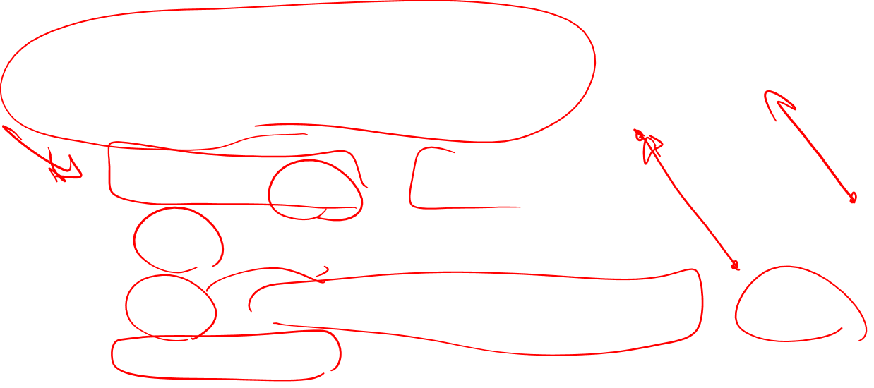
Embeddings reflect cultural bias
Bolukbasi, Tolga, Kai-Wei Chang, James Y. Zou, Venkatesh Saligrama, and Adam T. Kalai. "Man is to computer programmer as woman is to homemaker? debiasing word embeddings." In Advances in Neural Information Processing Systems, pp. 4349-4357. 2016.
Ask “Paris : France :: Tokyo : x”
x = Japan
Ask “father : doctor :: mother : x”
x = nurse
Ask “man : computer programmer :: woman : x”
x = homemaker

Slide 41
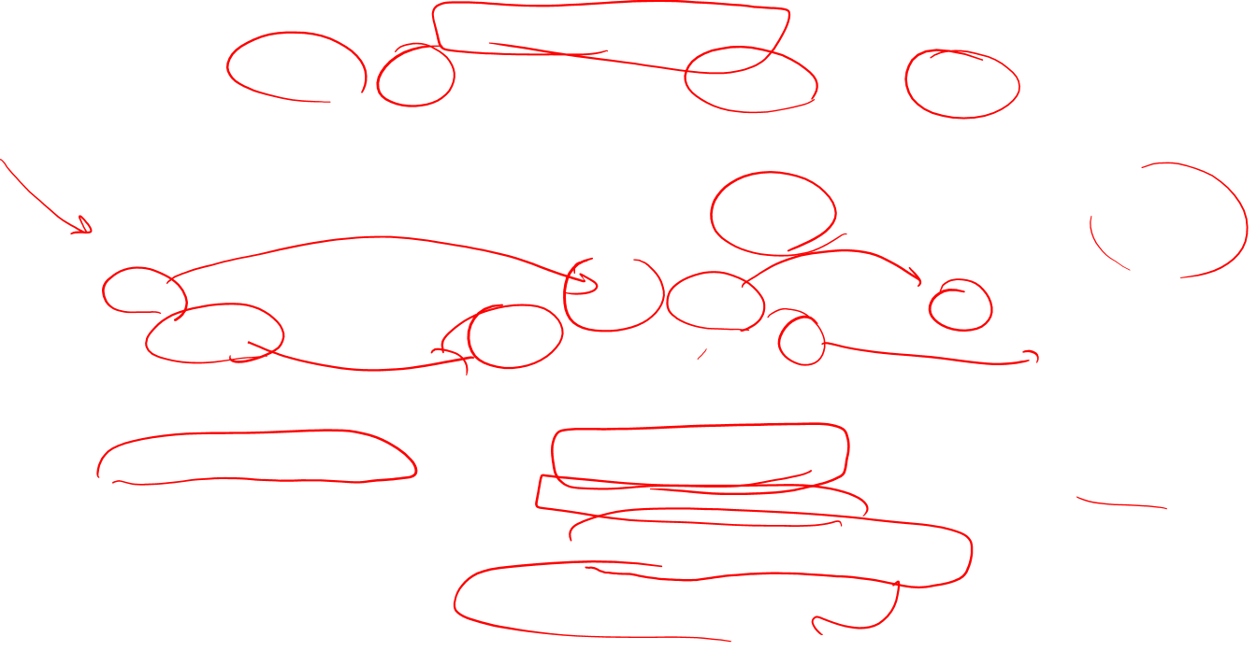
Embeddings reflect cultural bias
Caliskan, Aylin, Joanna J. Bruson and Arvind Narayanan. 2017. Semantics derived automatically from language corpora contain human-like biases. Science 356:6334, 183-186.
Implicit Association test (Greenwald et al 1998): How associated are
concepts (flowers, insects) & attributes (pleasantness, unpleasantness)?
Studied by measuring timing latencies for categorization.
Psychological findings on US participants:
African-American names are associated with unpleasant words (more than European-American names)
Male names associated more with math, female names with arts
Old people's names with unpleasant words, young people with pleasant words.
Caliskan et al. replication with embeddings:
African-American names (Leroy, Shaniqua) had a higher GloVe cosine with unpleasant words (abuse, stink, ugly)
European American names (Brad, Greg, Courtney) had a higher cosine with pleasant words (love, peace, miracle)
Embeddings reflect and replicate all sorts of pernicious biases.

Slide 42
Directions
Debiasing algorithms for embeddings
Bolukbasi, Tolga, Chang, Kai-Wei, Zou, James Y., Saligrama, Venkatesh, and Kalai, Adam T. (2016). Man is to computer programmer as woman is to homemaker? debiasing word embeddings. In Advances in Neural Infor- mation Processing Systems, pp. 4349–4357.
Use embeddings as a historical tool to study bias

Slide 43
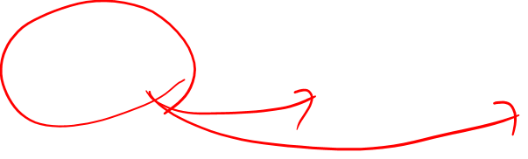
Embeddings as a window onto history
Garg, Nikhil, Schiebinger, Londa, Jurafsky, Dan, and Zou, James (2018). Word embeddings quantify 100 years of gender and ethnic stereotypes. Proceedings of the National Academy of Sciences, 115(16), E3635–E3644
Use the Hamilton historical embeddings
The cosine similarity of embeddings for decade X for occupations (like teacher) to male vs female names
Is correlated with the actual percentage of women teachers in decade X

Slide 44

History of biased framings of women
Garg, Nikhil, Schiebinger, Londa, Jurafsky, Dan, and Zou, James (2018). Word embeddings quantify 100 years of gender and ethnic stereotypes. Proceedings of the National Academy of Sciences, 115(16), E3635–E3644
Embeddings for competence adjectives are biased toward men
Smart, wise, brilliant, intelligent, resourceful, thoughtful, logical, etc.
This bias is slowly decreasing

Slide 45

Embeddings reflect ethnic stereotypes over time
Garg, Nikhil, Schiebinger, Londa, Jurafsky, Dan, and Zou, James (2018). Word embeddings quantify 100 years of gender and ethnic stereotypes. Proceedings of the National Academy of Sciences, 115(16), E3635–E3644
Princeton trilogy experiments
Attitudes toward ethnic groups (1933, 1951, 1969) scores for adjectives
industrious, superstitious, nationalistic, etc
Cosine of Chinese name embeddings with those adjective embeddings correlates with human ratings.

Slide 46
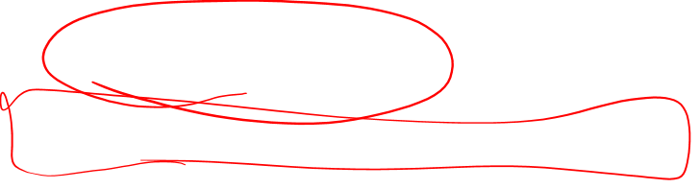
Change in linguistic framing 1910-1990
Garg, Nikhil, Schiebinger, Londa, Jurafsky, Dan, and Zou, James (2018). Word embeddings quantify 100 years of gender and ethnic stereotypes. Proceedings of the National Academy of Sciences, 115(16), E3635–E3644
Change in association of Chinese names with adjectives framed as "othering" (barbaric, monstrous, bizarre)

Slide 47
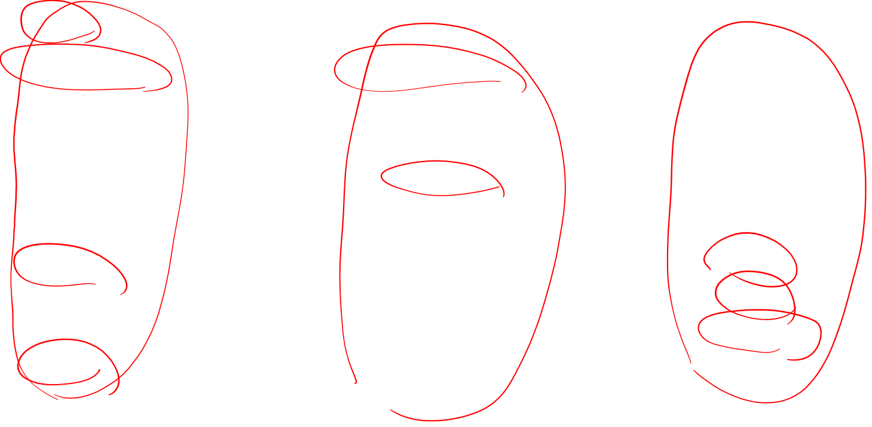
Changes in framing: adjectives associated with Chinese
Garg, Nikhil, Schiebinger, Londa, Jurafsky, Dan, and Zou, James (2018). Word embeddings quantify 100 years of gender and ethnic stereotypes. Proceedings of the National Academy of Sciences, 115(16), E3635–E3644

Slide 48

Conclusion
Concepts or word senses
Have a complex many-to-many association with words (homonymy, multiple senses)
Have relations with each other
Synonymy, Antonymy, Superordinate
But are hard to define formally (necessary & sufficient conditions)
Embeddings = vector models of meaning
More fine-grained than just a string or index
Especially good at modeling similarity/analogy
Just download them and use cosines!!
Can use sparse models (tf-idf) or dense models (word2vec, GLoVE)
Useful in practice but know they encode cultural stereotypes

Slide 49
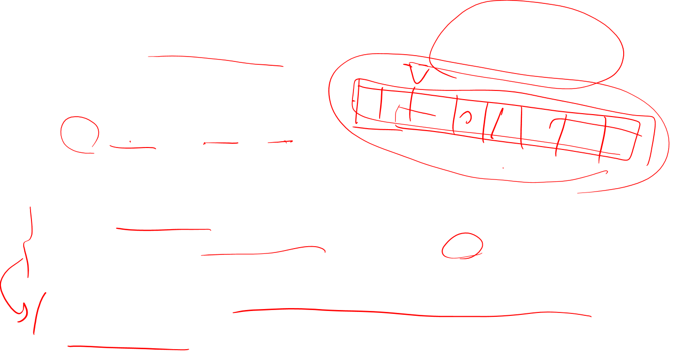
Bibliographical and Historical Notes
1950-60: mechanical indexing, now known as information retrieval
Vector space model
1960: semantic features
hen +female, +chicken, +adult
rooster -female, +chicken, +adult
chick +chicken, -adult
Use of dense vectors to model word meaning was the latent semantic indexing (LSI): LSA, singular value decomposition(SVD):
the first 300 important dimensions are used instead of all dimentions
More work on SVD: Probabilistic Latent Semantic Indexing (PLSI), Latent Dirichlet Allocation (LDA)

Slide 50
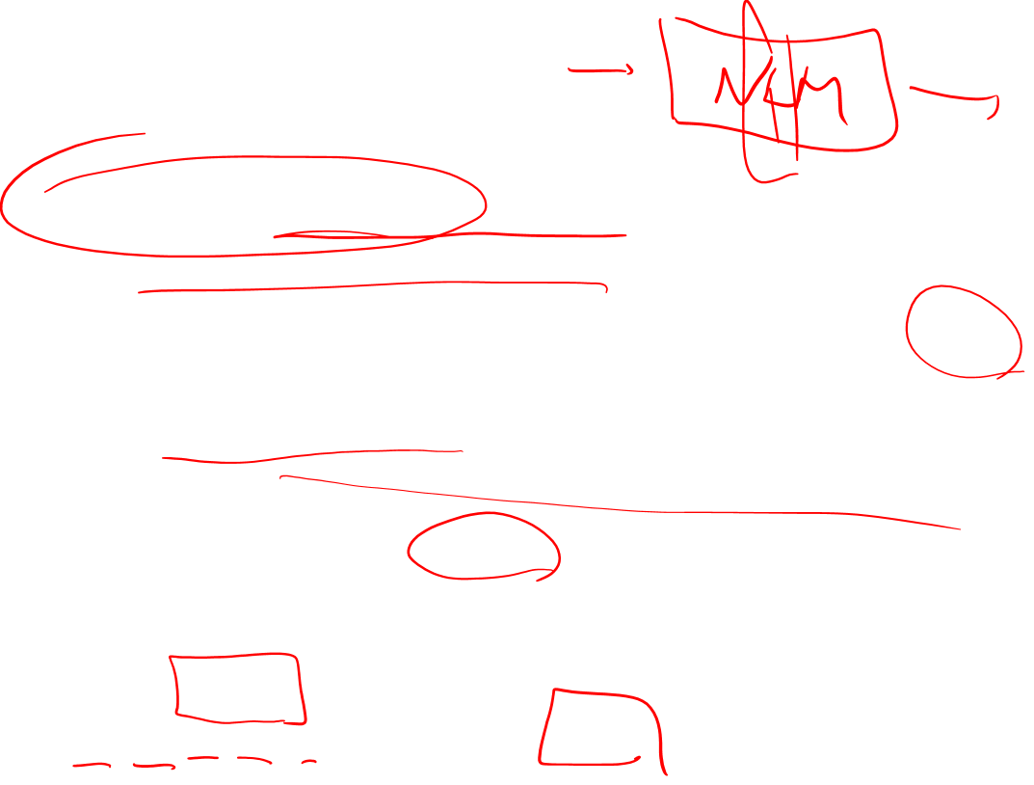
Bibliographical and Historical Notes
2003: Bengio: Neural Language model
The idea of using hidden layer of NLM for embedding skip-gram and CBOW
Mikolov: simpligy the NLM to logistic regression
most widely-used embedding model besides word2vec is GloVe: Global Vector
capturing global corpus statistics
based on ratios of probabilities from the word-word co-occurrence matrix
An extension of word2vec, fasttext deals with unknown words and sparsity in languages with rich morphology
Use character n-grams too
For word “where”
<wh, whe, her, ere, re> plus the sequence <where>

